Slide 1
Mental retardation
The presentation was made by
Yakovleva Elizaveta
The student of the 18th group
Educational path: «Psychology and pedagogy inclusive education»
Tver, 2016

Slide 2
What is mental retardation?
The condition of having an IQ measured as below 70 to 75 and significant delays or lacks in at least two areas of adaptive skills.

Slide 3
What are the signs of mental retardation in children?
Rolling over, sitting up, crawling, or walking late
Talking late or having trouble with talking
Slow to master things like potty training, dressing, and feeding himself or herself
Difficulty remembering things
Inability to connect actions with consequences
Behavior problems such as explosive tantrums
Difficulty with problem-solving or logical thinking

Slide 4
What causes mental retardation?
Genetic conditions. These include things like Down syndrome and fragile X syndrome.
Problems during pregnancy.
Problems during childbirth.
Illness or injury. Infections like meningitis, whooping cough, or the measles can lead to mental retardation.
None of the above, because the cause is unknown.

Slide 5
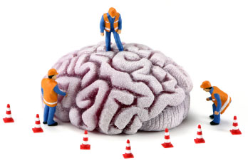
How is mental retardation diagnosed?
These include blood tests, urine tests, imaging tests to look for structural problems in the brain.
After a diagnosis of is made, a team of mental retardation professionals will assess the child’s particular strengths and weaknesses.

Slide 6
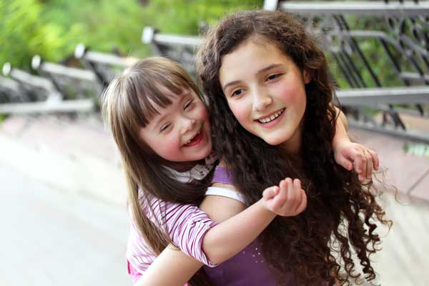
What can I do to help my mental retardation child?
Learn everything you can about mental retardation. The more you know, the better advocate you can be for your child.
Encourage your child’s independence.
Get your child involved in group activities. Help your child build social skills.
Stay involved. By keeping in touch with your child’s teachers.
Get to know other parents of mental retardation children. They can be a great source of advice and emotional support.

Slide 7
Сonclusion:
Generally speaking, the symptoms of mental retardation include delays in oral language development, deficits in memory skills, difficulty learning social roles. Child has difficulty problems solving skills.

Slide 8
Вibliography
Nikishina V. B. Practical psychology in work with children with mental retardation. - M., 2003
Markov I. F. Clinical and neuropsychological bases of diagnostics and correction of mental retardation in children. – M., 1991

Slide 9
Thank you for your attention!

