Slide 1
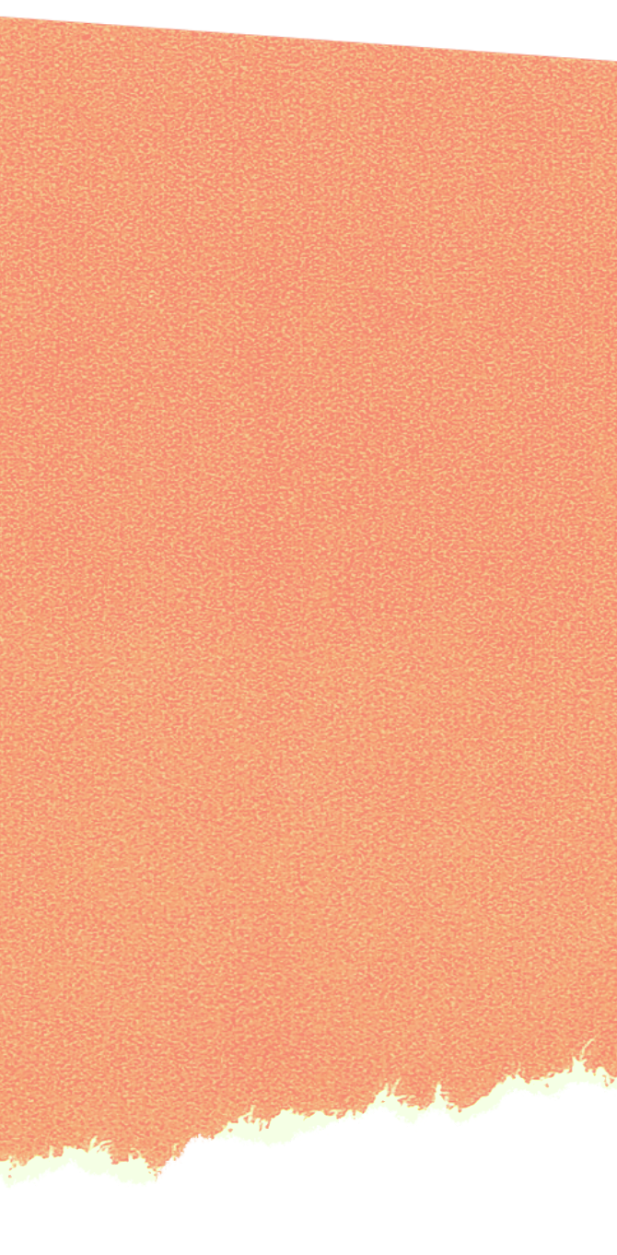
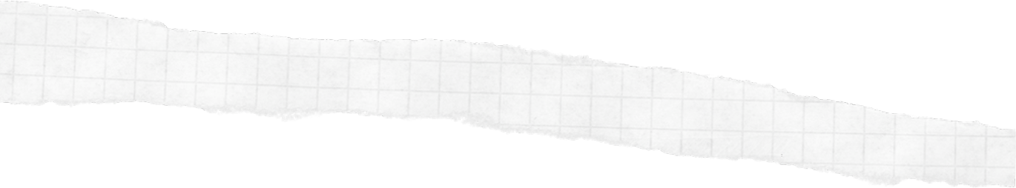
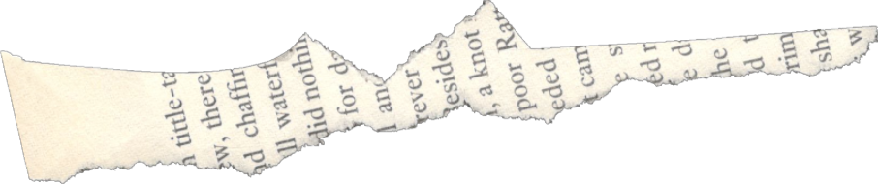

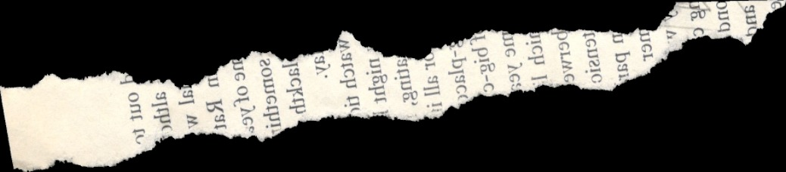
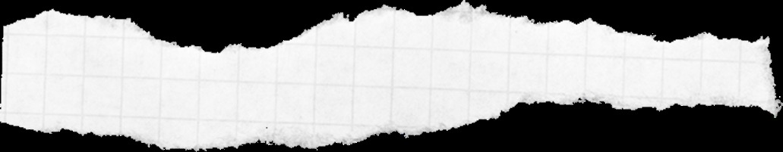
Вопросы с глаголом
TO BE

Slide 2

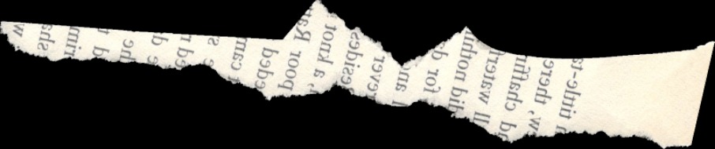
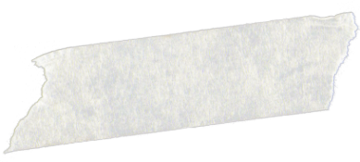
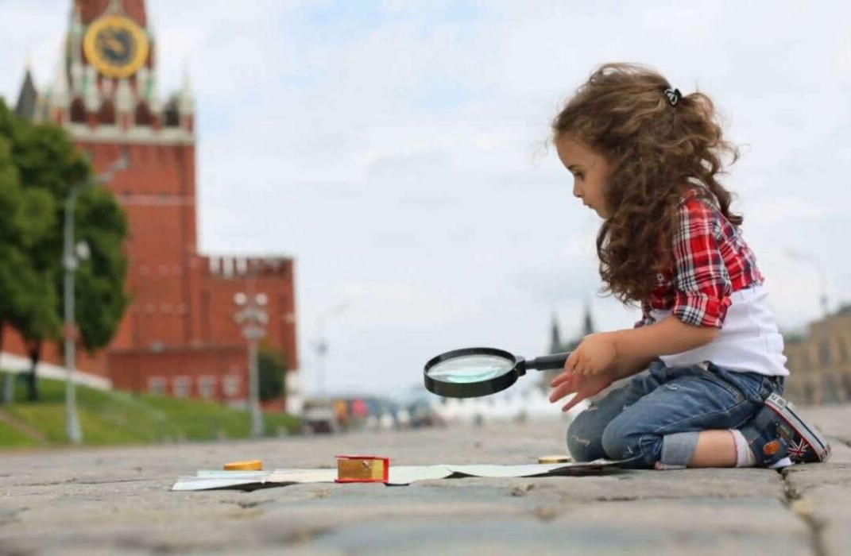

ARE YOU FROM MOSCOW?
Ты из Москвы?

Slide 3
YES, I AM
Да

Slide 4
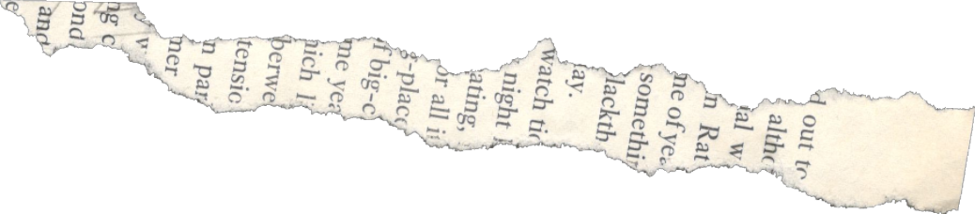
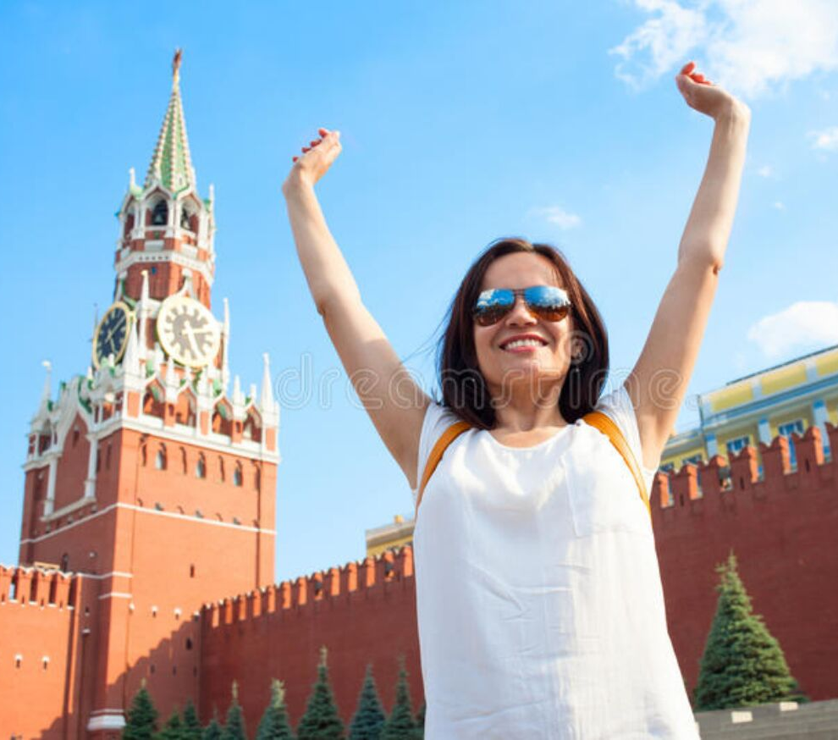


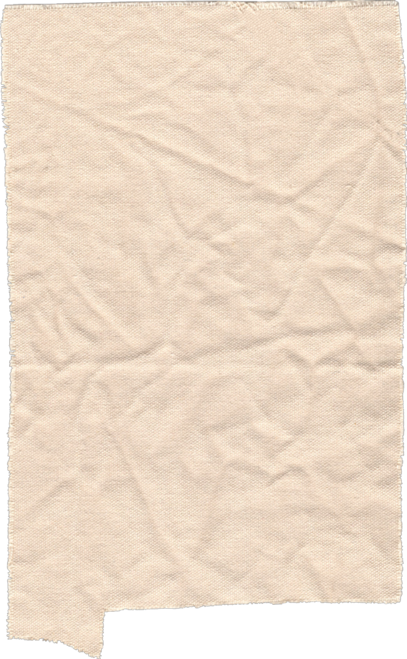
I am Russian
Я РУССКАЯ

Slide 5
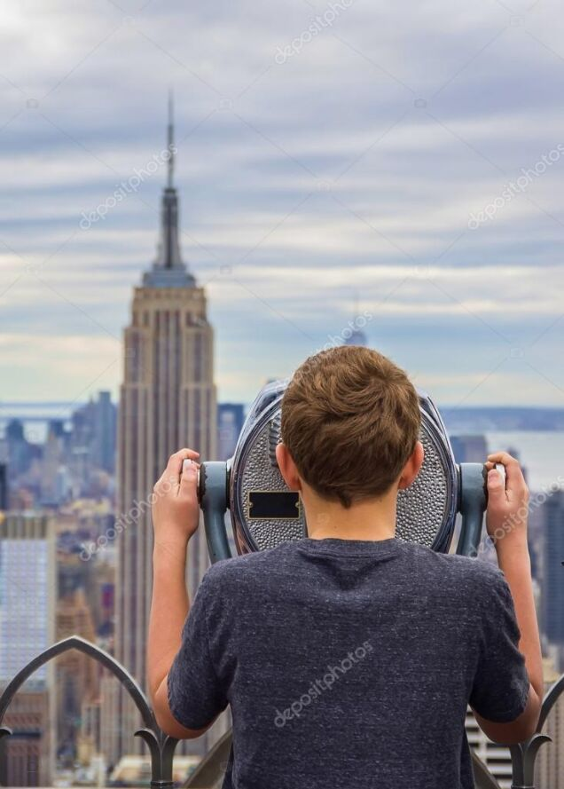
Is he from New York?
ОН ИЗ НЬЮ-ЙОРКА?

Slide 6
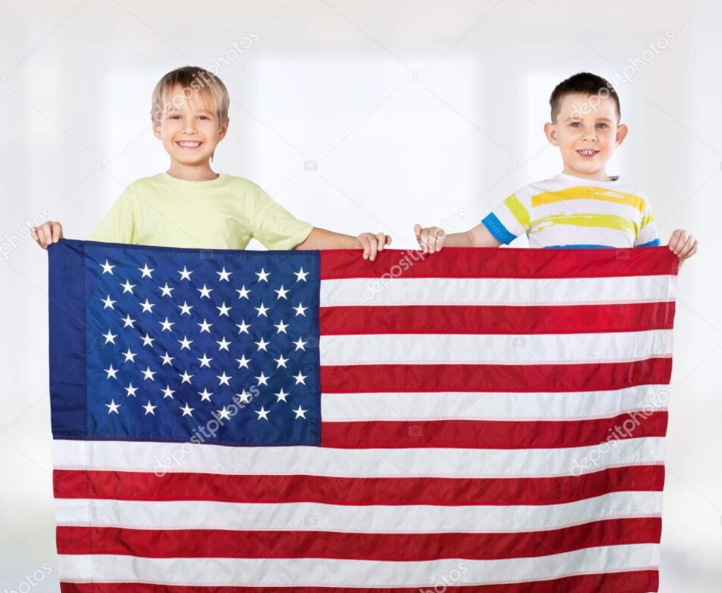
-ARE THEY CANADIAN?
ОНИ КАНАДЦЫ?

Slide 7
NO, THEY ARE NOT. THEY ARE AMERICAN
Нет. Они Американцы

Slide 8

Запишем:
Am I
Are you
he
Is she
it
Are we
Are you
Are they

