Slide 1
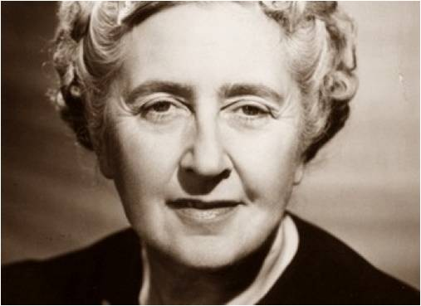
Agatha Christie
Year of life
15.09.1890г. – 12. 01. 1976г.

Slide 2
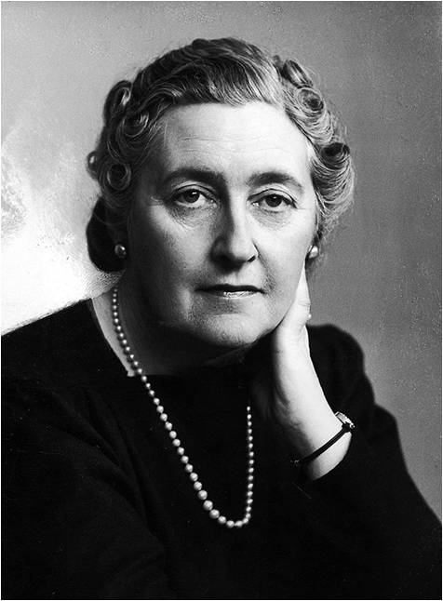
Personal life

Slide 3
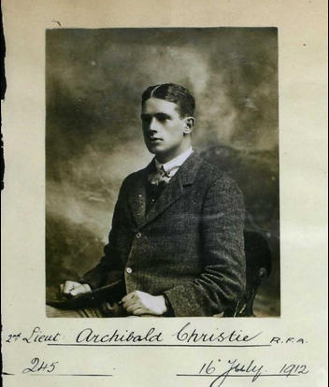
Archibald Christie
Archie was born in India, the son of a judge in the Indian Civil Service. He was an army officer who was seconded to the Royal Flying Corps in April 1913. The couple quickly fell in love.

Slide 4
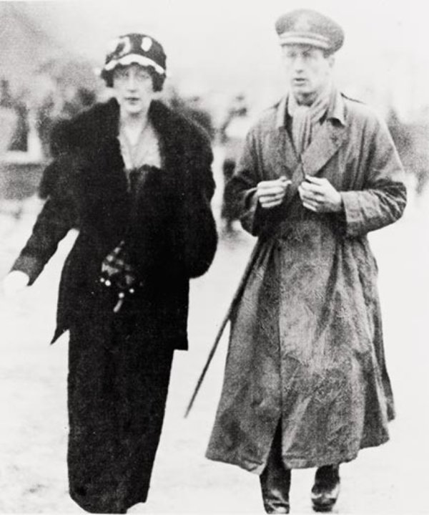

Slide 5
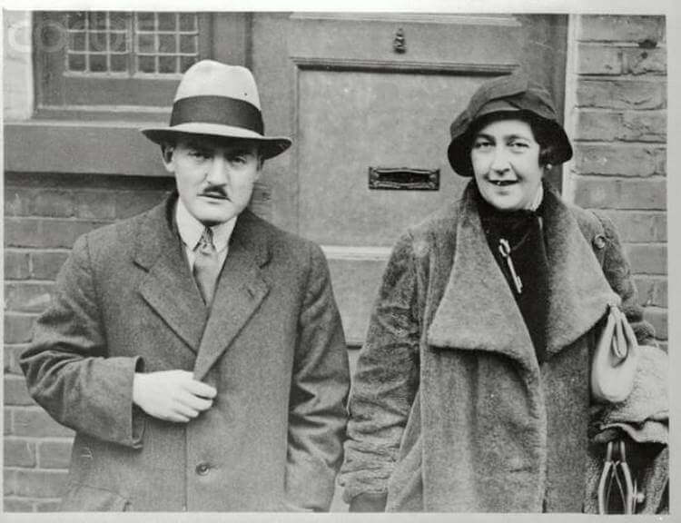
Max Mallowan

Slide 6
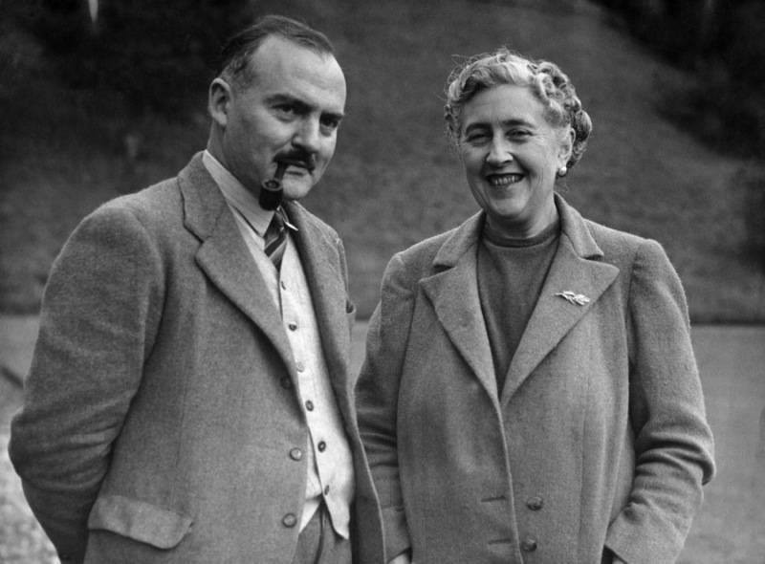

Slide 7
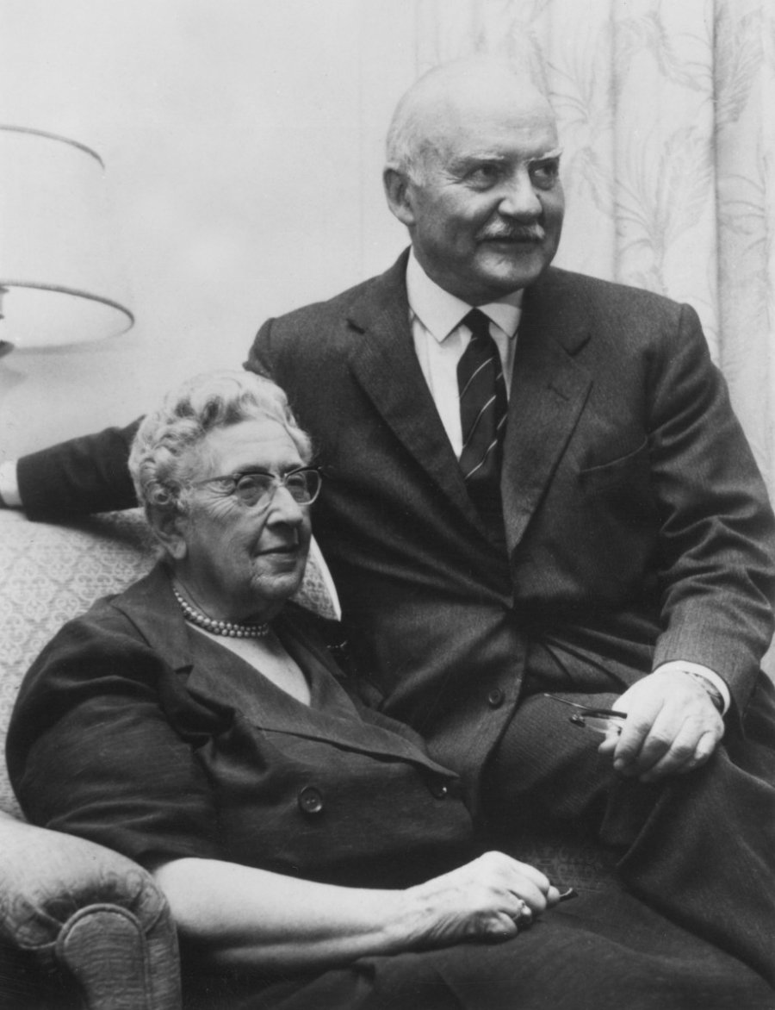
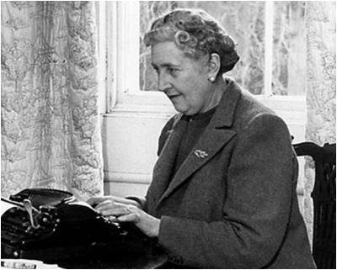
Their marriage was happy and lasted until Christie’s death in 1976.

Slide 8
thank you for your attention

