Slide 1
English for business http://www.englishforbusiness.ru/

Slide 11
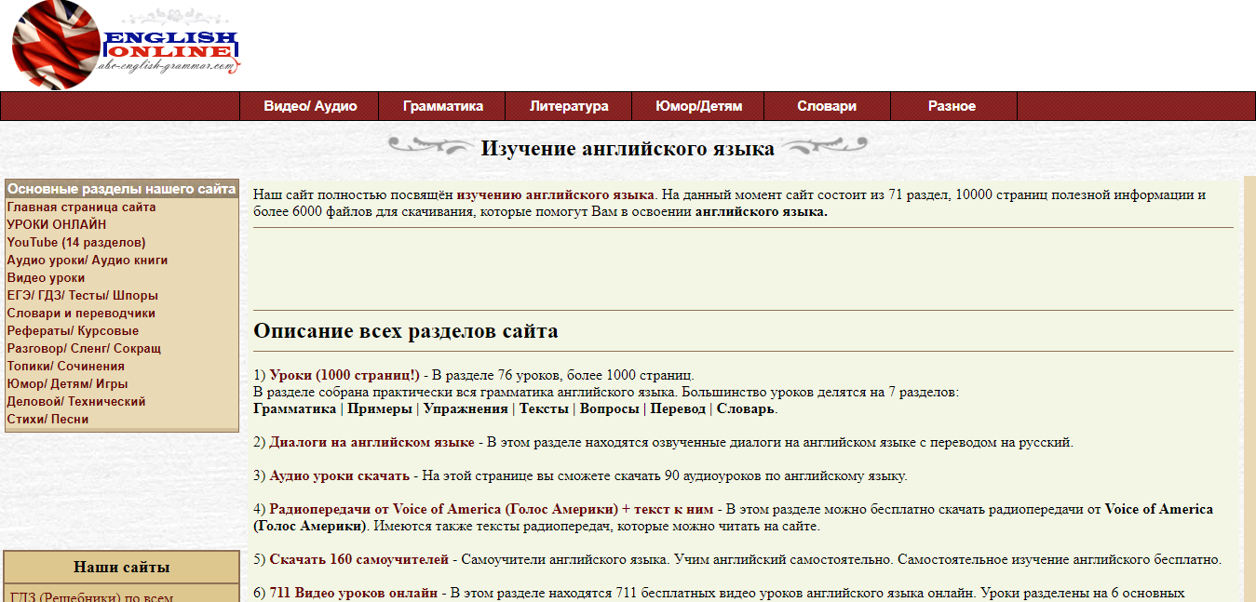
English online http://abc-english-grammar.com/

Slide 22
Fluent English http://www.fluent-english.ru/

